Slide 1
Travis Vanos 0482566
INDS-1057 – Research Project -Castle Design

Slide 2
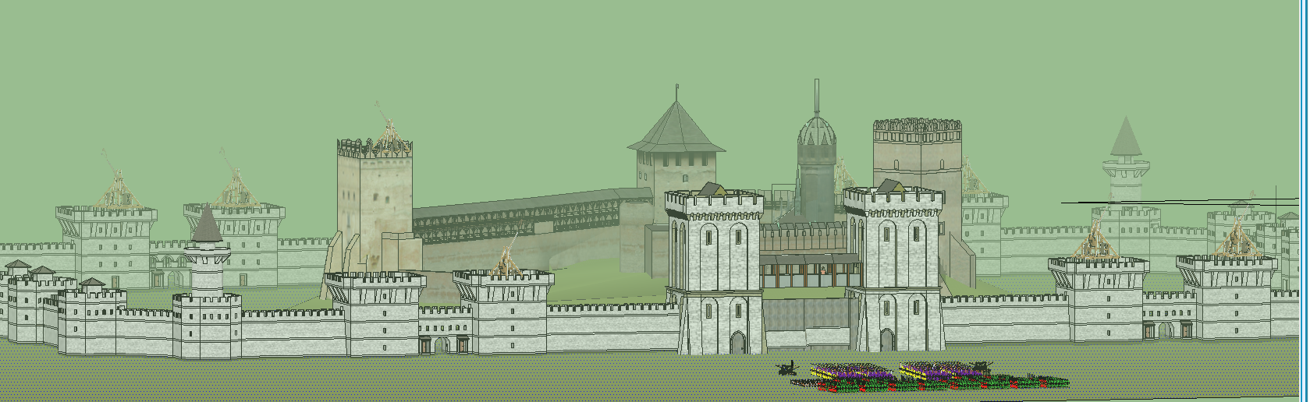
Vanos’ Castillo
* Design done by Travis Vanos * Texture and renderings found on Google 3D Warehouse.

Slide 3
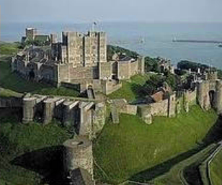
Location
Ideally on a natural hill or mound
Access to water and a superb view of surroundings
Similar shape and structure to Dover Castle in Dover, Kent, England
The castle would be impregnable and held by a large force

Slide 4
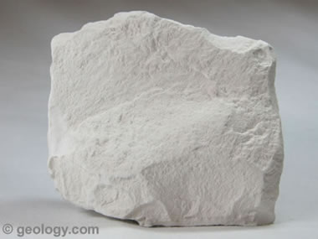
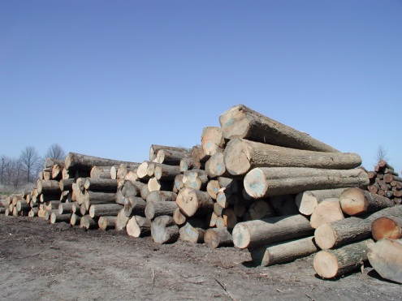
Materials and Build List
Although resource gathering would be tough, as much limestone would be collected as possible for stone use
Oak would be used as well whenever possible for structural stability
White limestone would be used uniformly for the castle’s walls (aesthetics)
Castle tenants would provide labour in exchange for protection and minimal pay
The minimum amount of workers (skilled/unskilled) would be 3000 during peak construction

Slide 5
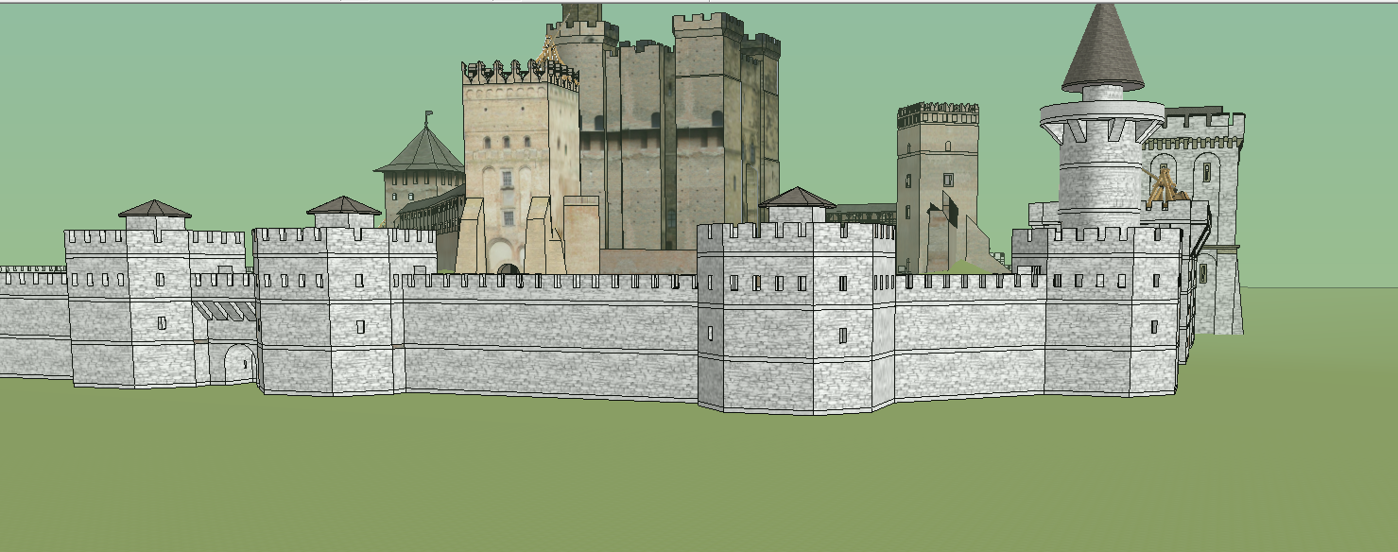
Curtain Wall
This castle would be of enceinte design
Strong outer walls, corner towers would be polygonal in shape

Slide 6
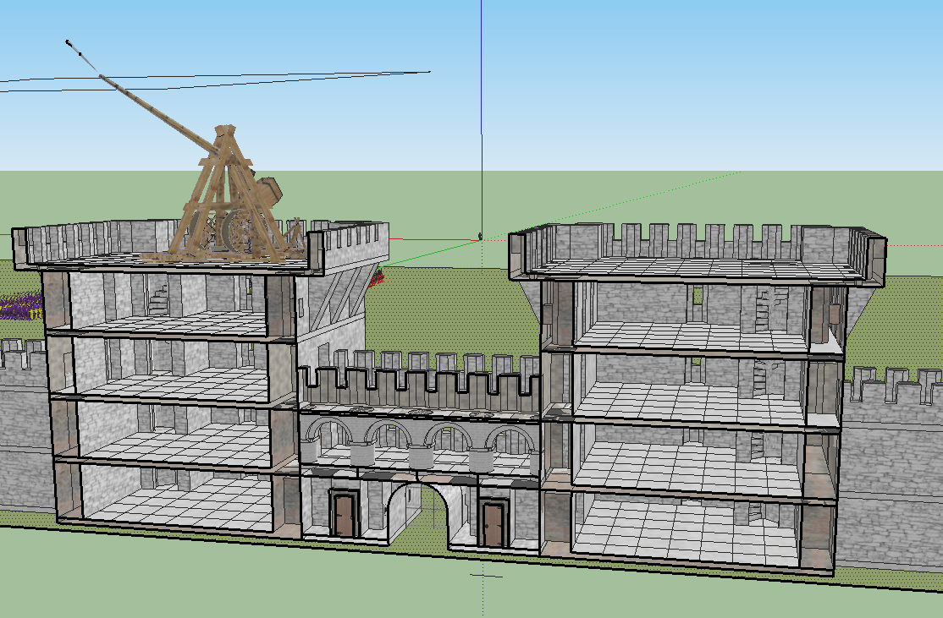
Battlements
Sturdy square towers provide lots of space for soldiers or supply's
Machicolations can be used by archers to defend against attacking armies
Curtain Wall
Trebuchet
Crenellations
Machicolations
Sally port (other side)

Slide 7
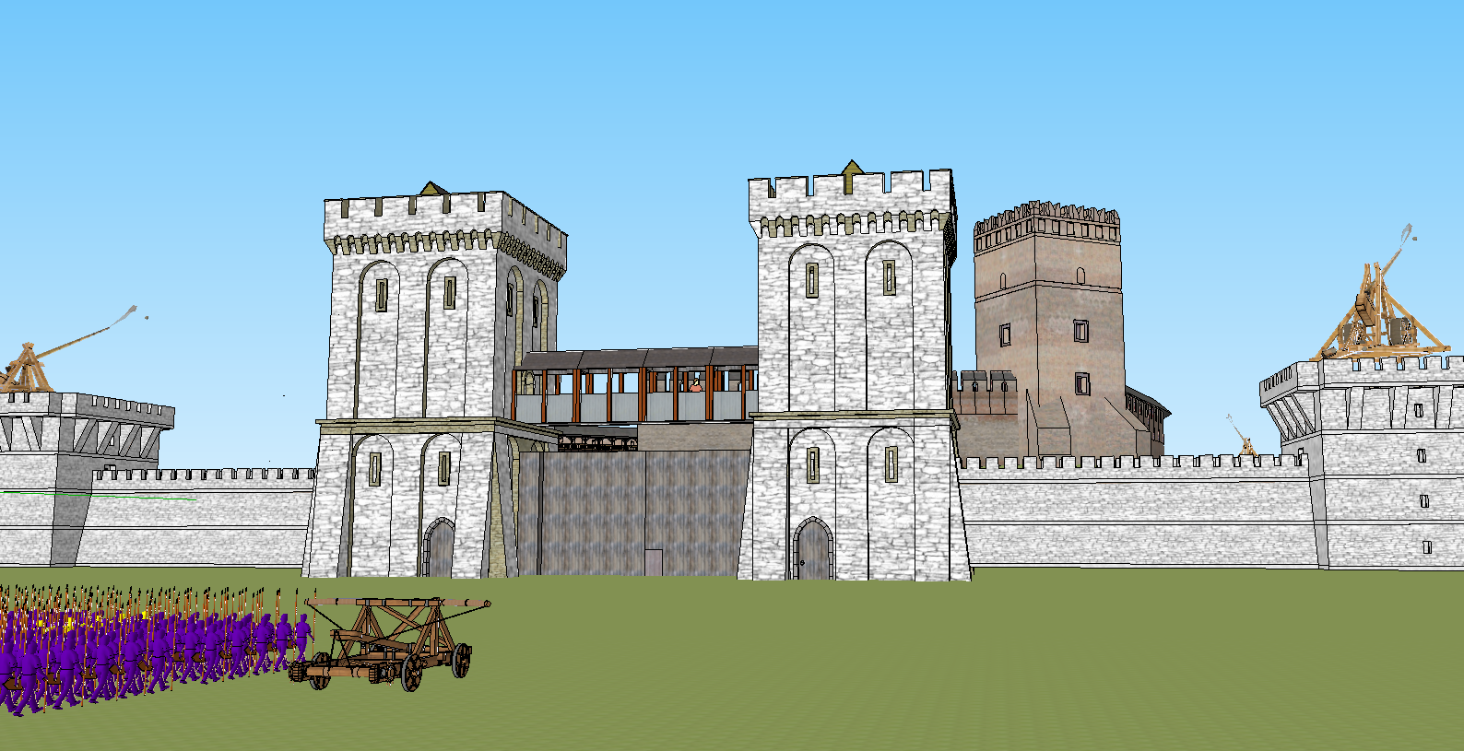
Gatehouse
- Structurally the weakest part of the fortification - The gate would have a narrow bridge leading to the gate for enemies to be under fire in a confined space - Hatched openings above the gates (murder holes) would be used to drop heavy objects on the attacking army - The gate would be re-enforced heavy wood or iron
Archer Perch
Fortified gate (15 degree angle)
Murder Hole

Slide 8
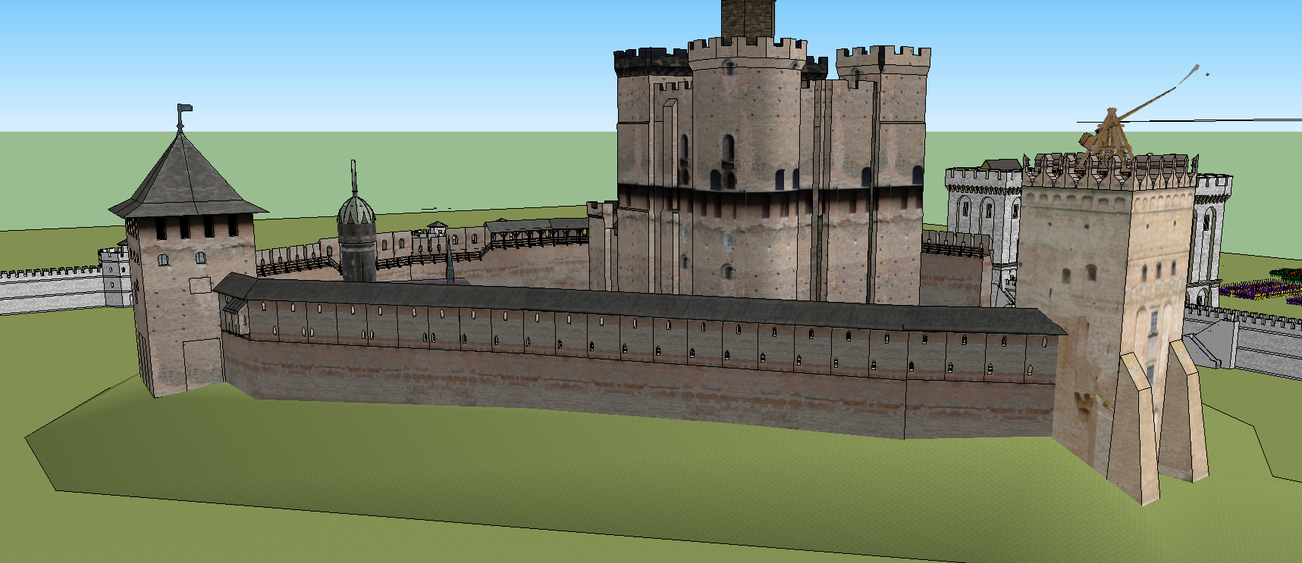
Castle Bailey
Enceinte
Church (Or other buildings e.x Barracks/stable)
Hoardings
Castle Keep
A strategic position was needed so the keep was on a raised mound (similar to a motte)
Last line of defense so the keep was the strongest and hardest to reach
Few windows in the keep, surrounded by building such as churches and barracks
Very large; pure stone

Slide 9
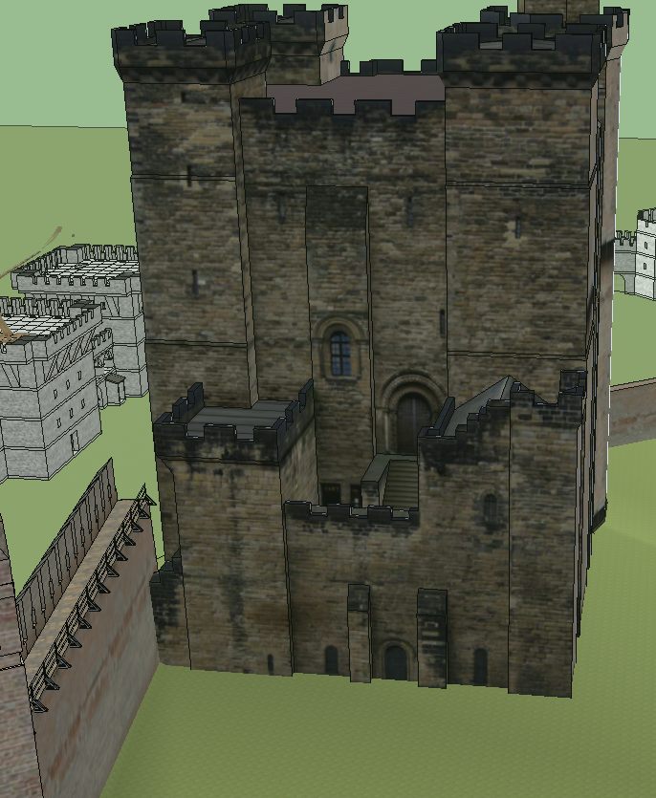
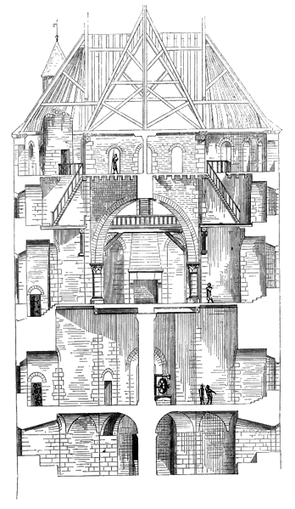
Castle Keep
Largest Structure
Served as the last resort against attack
Also called the “donjon” and would encompass the underground dungeon
Glass windows would be used, due to their expensive nature they would be removed when I was absent
Tower would be tall and non direct path to the royalty chambers

Slide 10
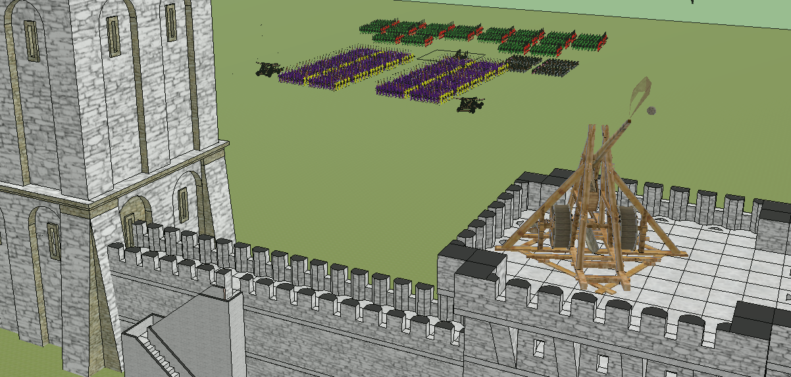
Siege Engines
Trebuchets would be the primary siege engine
Stones would be used for attack
Dead animal carcasses or humans would be used for intimidation

Slide 11
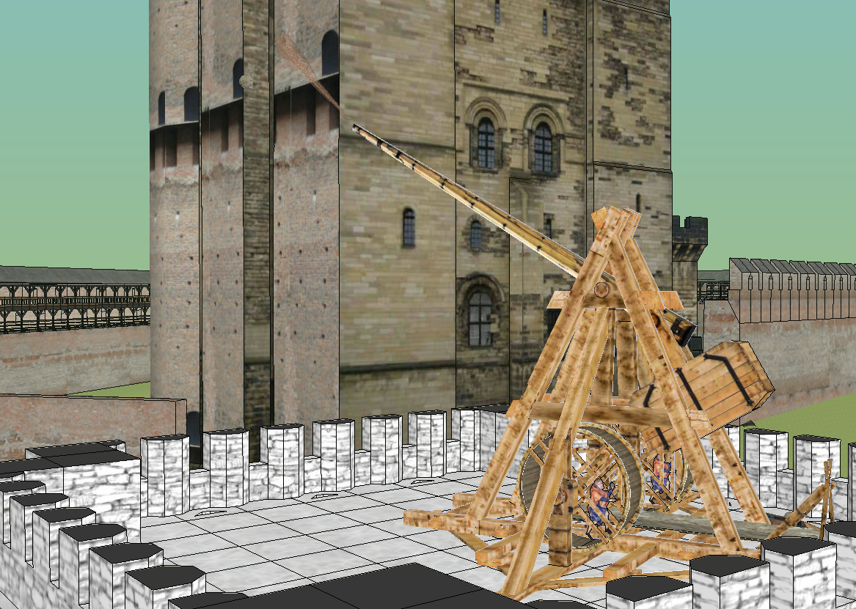
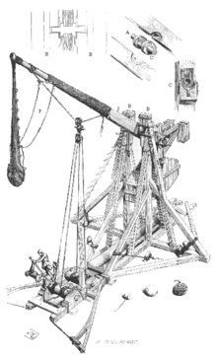
Counterweight Trebuchet
A counterweight trebuchet would be used; gunpowder was not widely used yet
Effective for long range
Close encounters would be dealt with archers

Slide 12
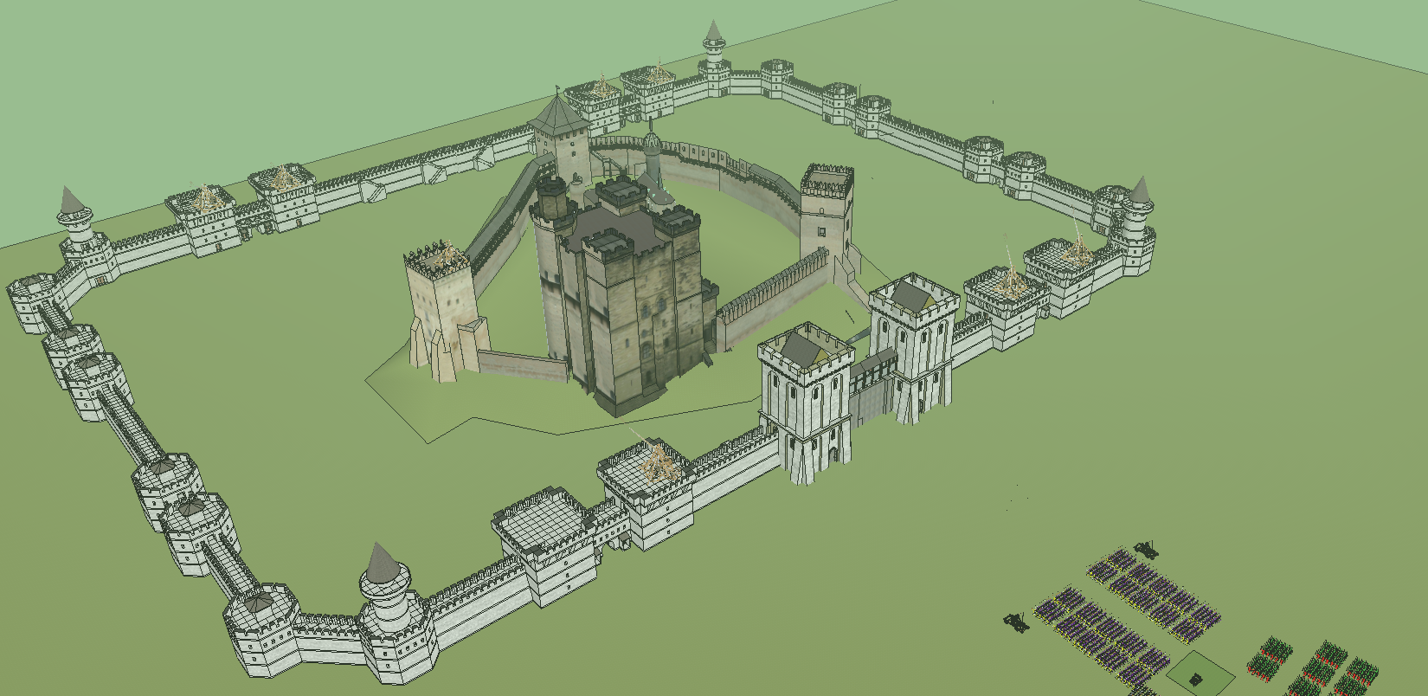
Castle Overveiw
Dirt or soil displaced by the motte or elevation could be used to build a moat for further defense (around castle or bailey)
Around the bailey is where lower class tenants of the castle would reside
Farmers would have farmland close to the castle for protection if it was needed

Slide 13
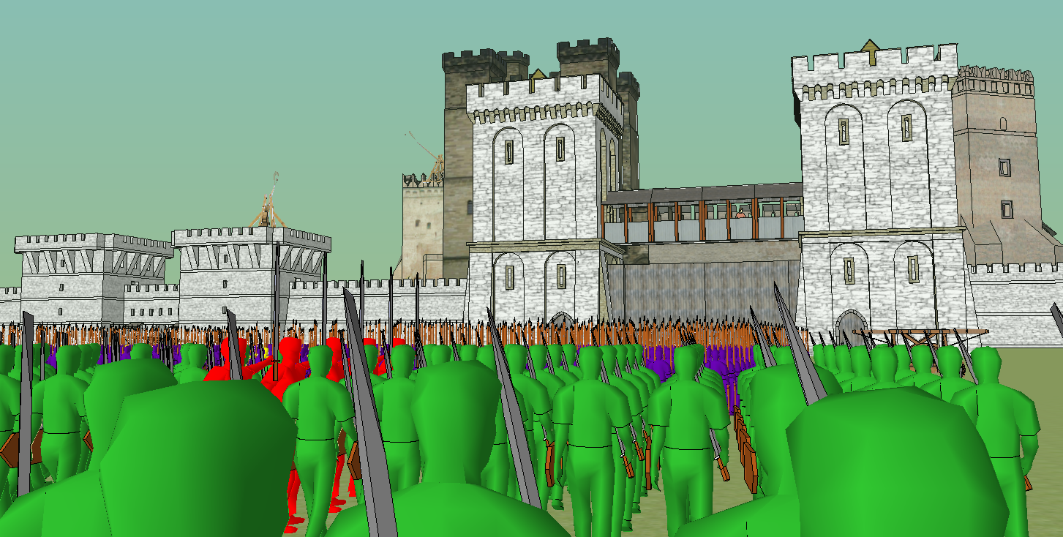
Intimidating Sight
- Size was important for a Lord’s status and intimidation among opposing forces

Slide 14
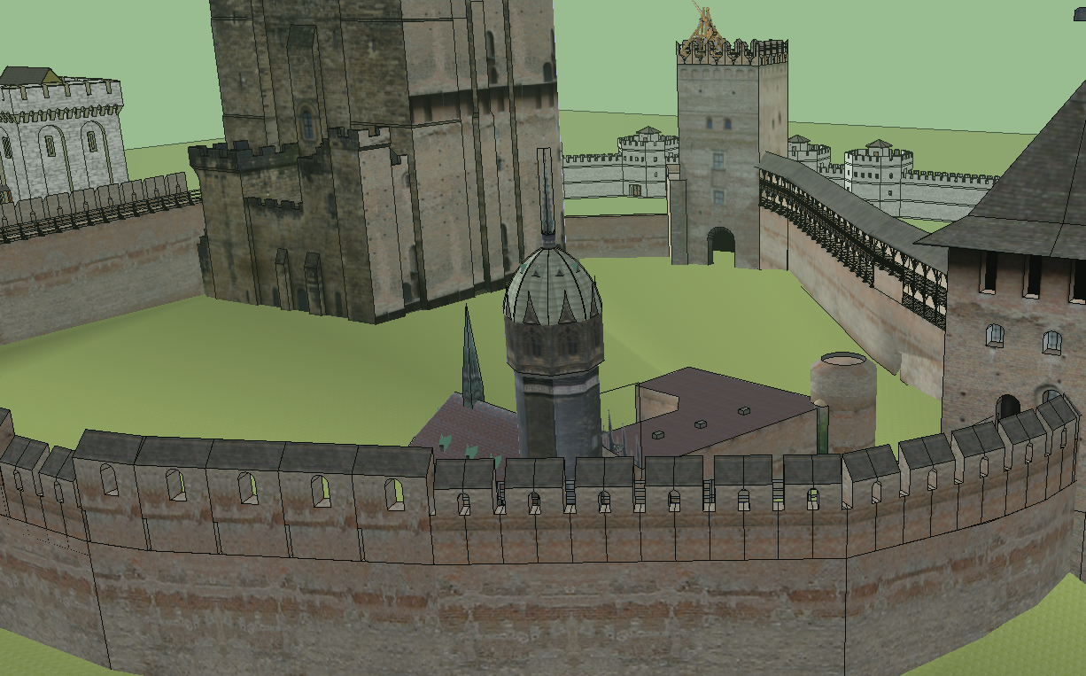
Cathedral as a Central Point

Slide 15
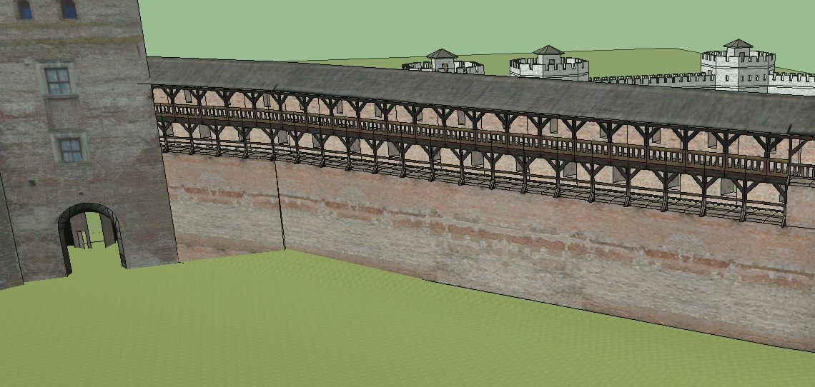
Hoardings
Used to shoot or drop objects on impeding armies
Made of sturdy oak

Slide 16
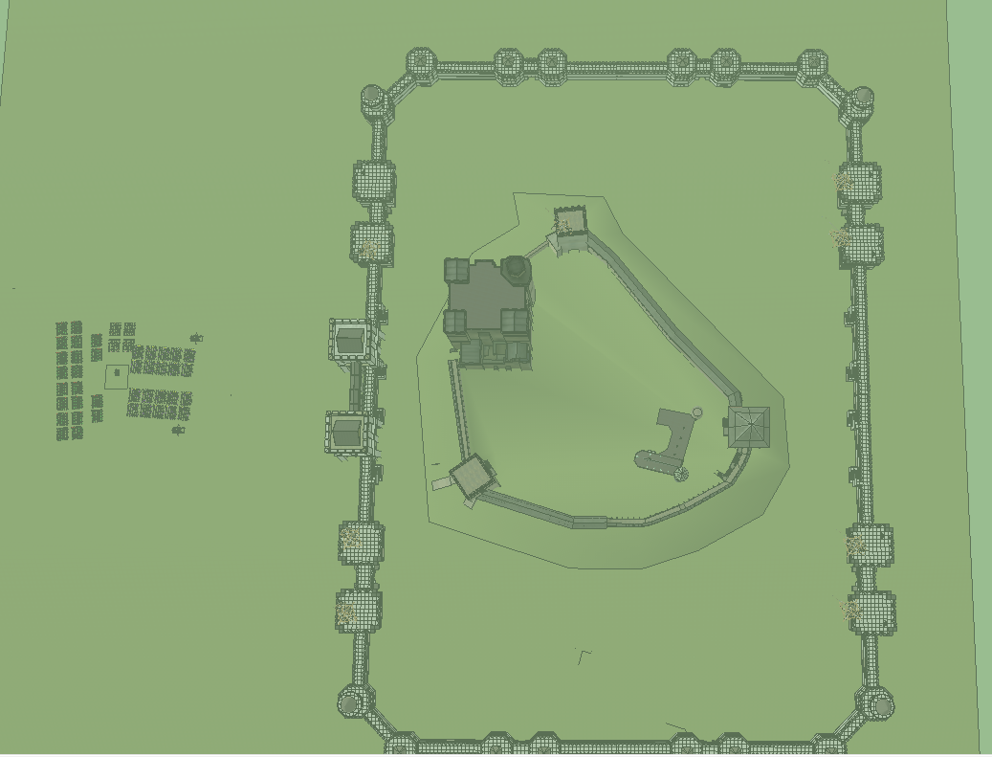

Slide 17
Chevedden, Paul E.; et al. (July 1995). "The Trebuchet". Scientific American: 66–71 Textures - sketchup.google.com/3dwarehouse/ - Grand Duke Dmitro Lubart’s castle in 1340 Army modeling - Calum Collins http://sketchup.google.com/3dwarehouse/details?mid=6ef88a372ac365767011e88184b7b188&prevstart=0

